Slide 1

Factorial of a number
N. Tapaswi
2100031010
Notes:
NOTE:
To change the image on this slide, select the picture and delete it. Then click the Pictures icon in the placeholder to insert your own image.

Slide 2
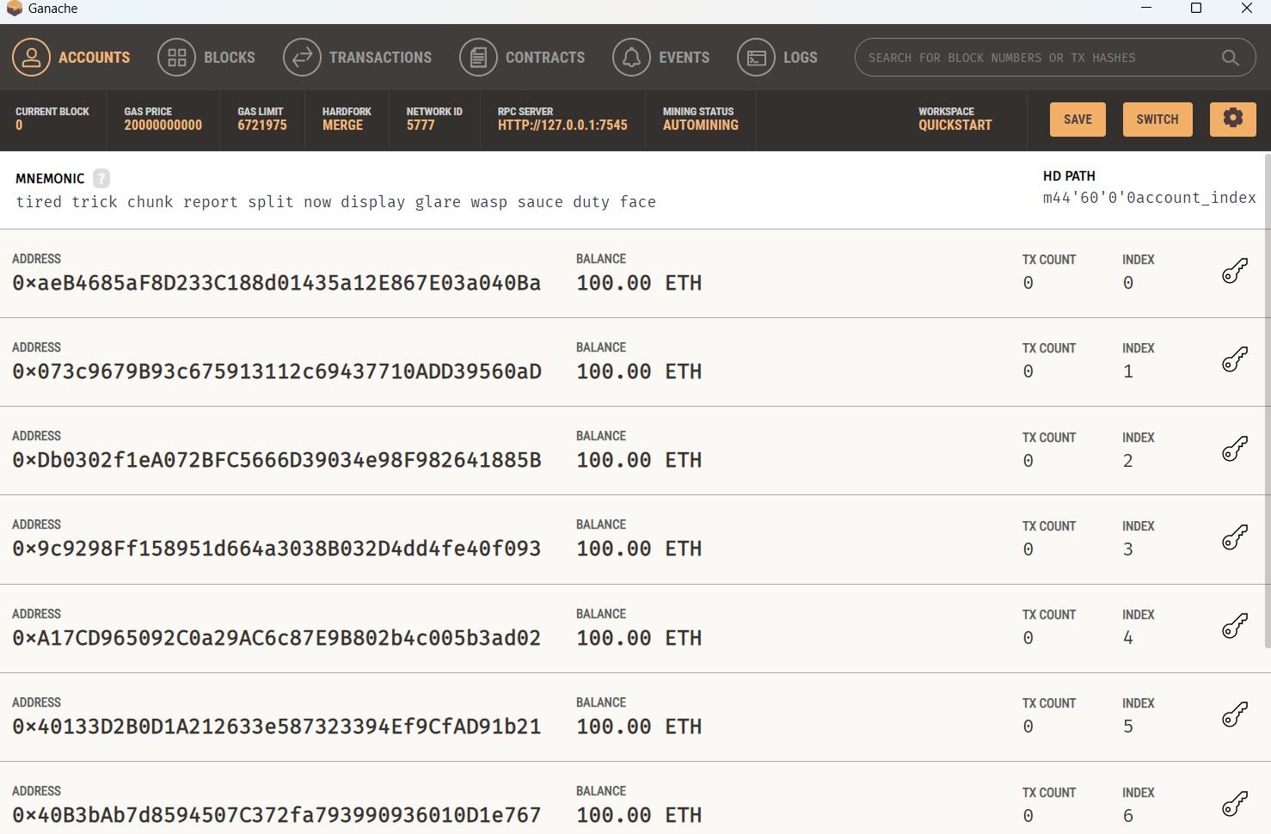
Ganache:

Slide 3
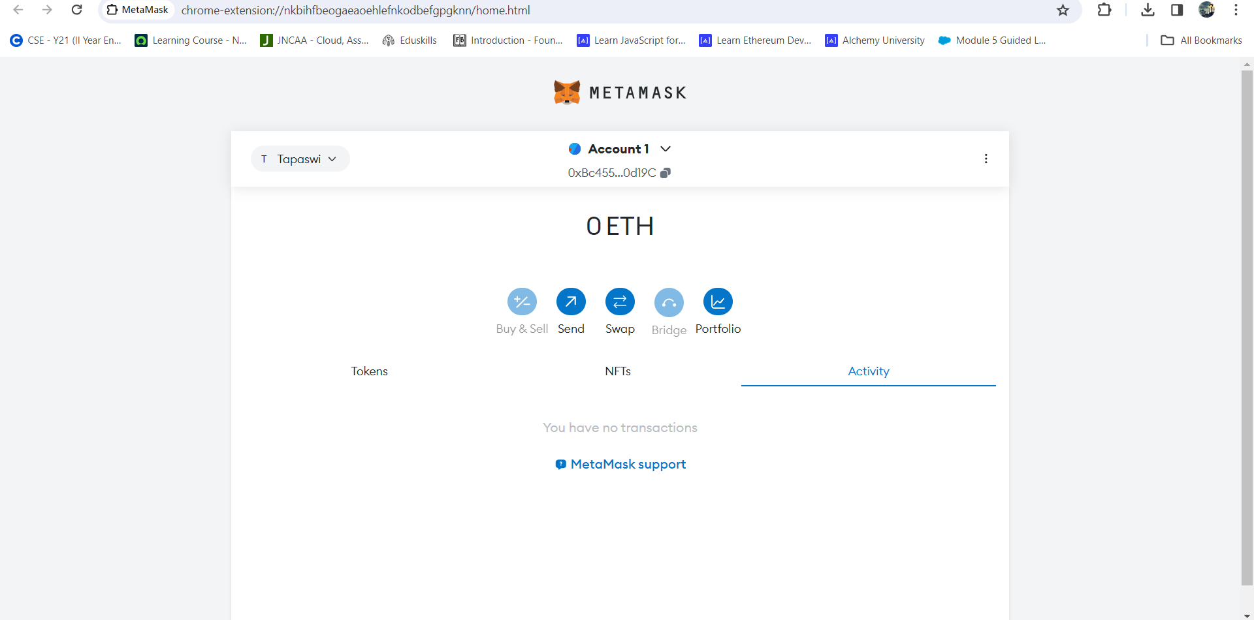
Metamask:

Slide 4
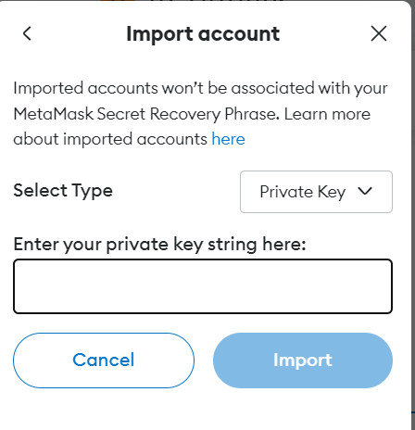
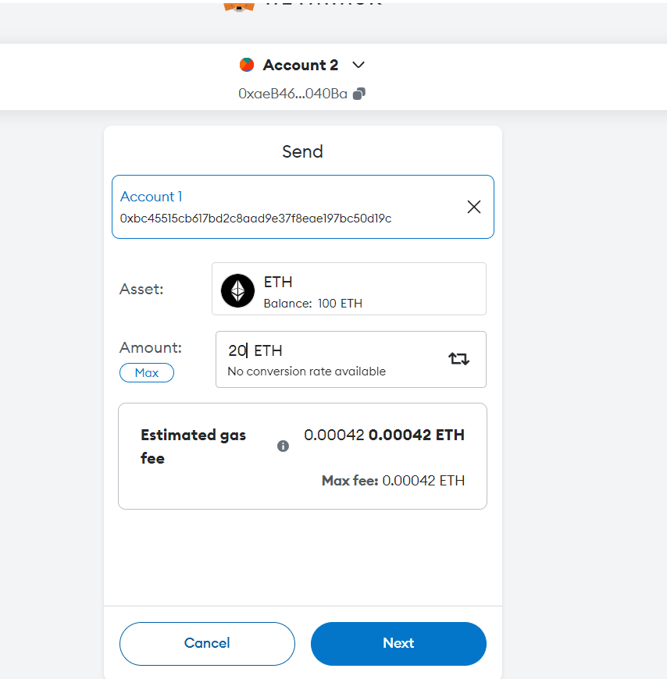
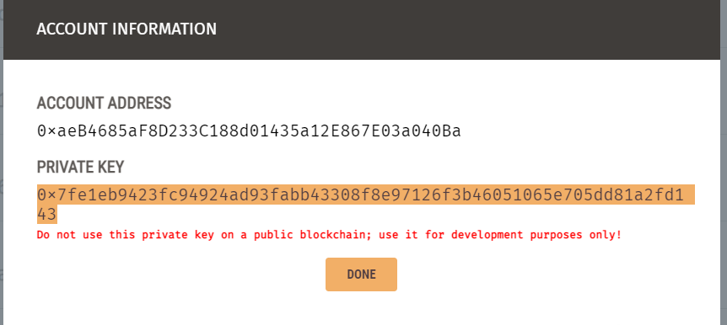

1)
3)
2)

Slide 5
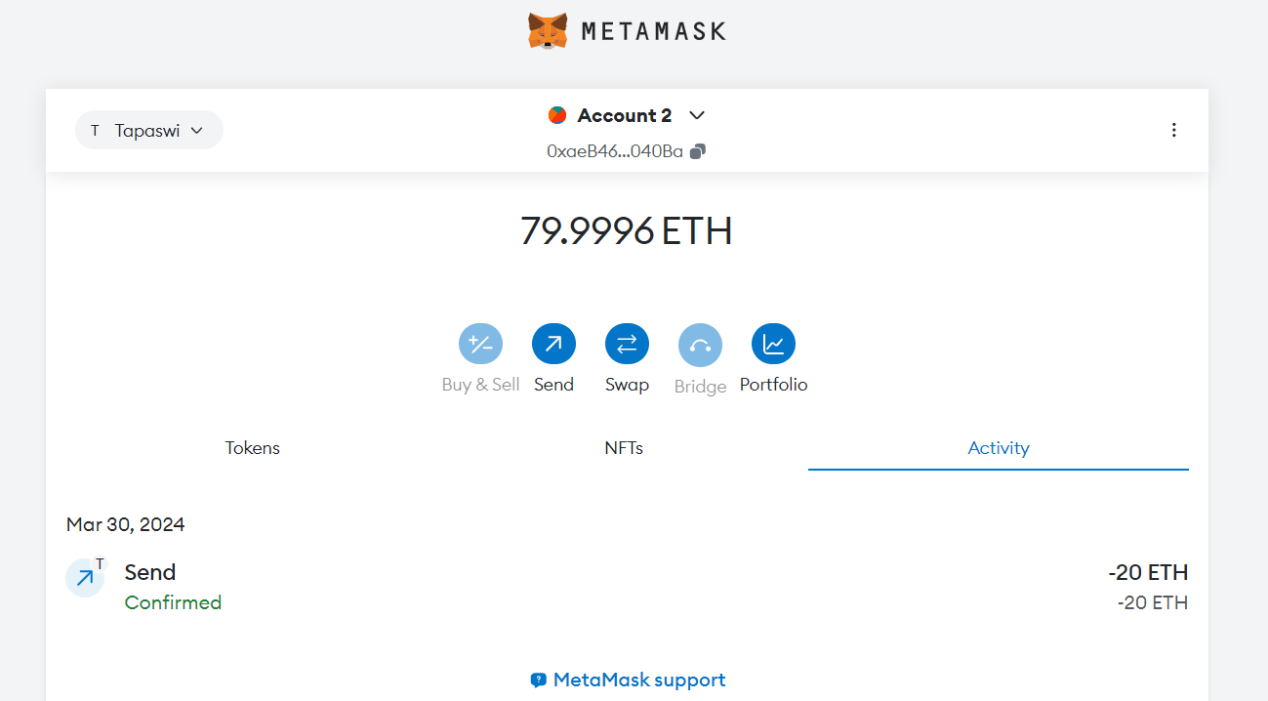

Slide 6
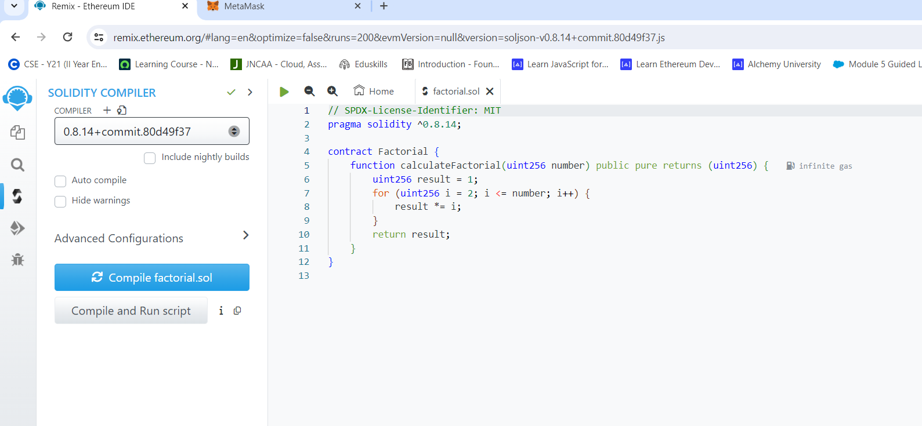
Compiling the factorial program in remixIDE

Slide 7
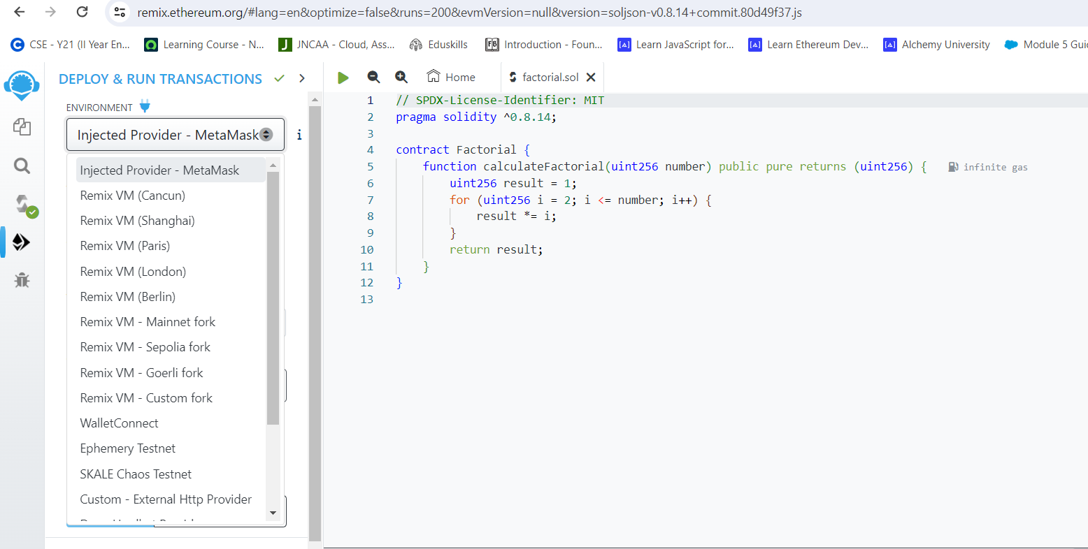
Deploying the factorial program with metamask

Slide 8
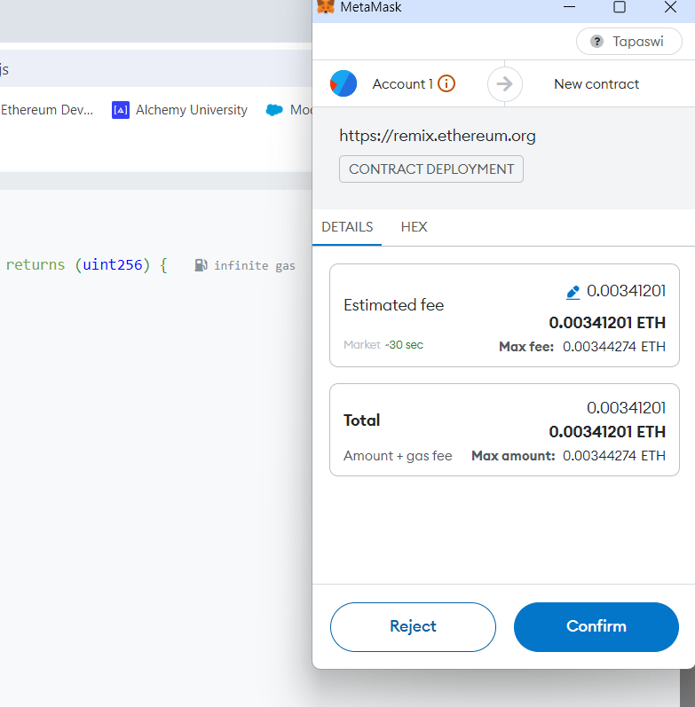
Confirming the transaction fee
with metamask and continuing the deployment of the factorial
Program:

Slide 9
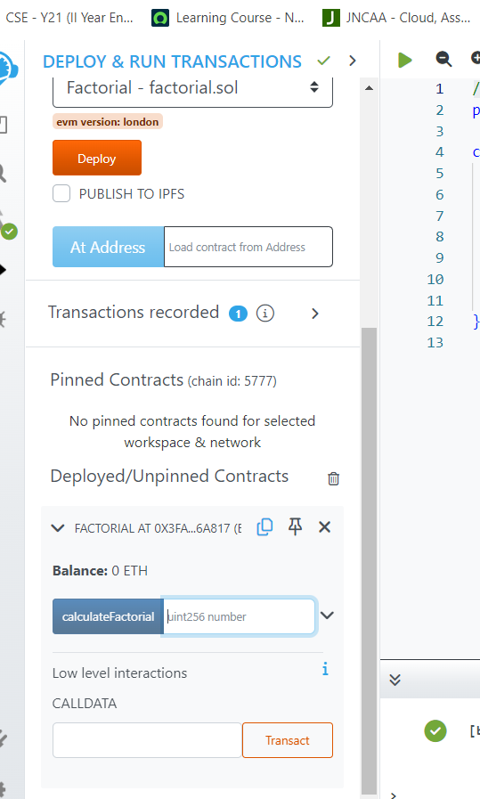
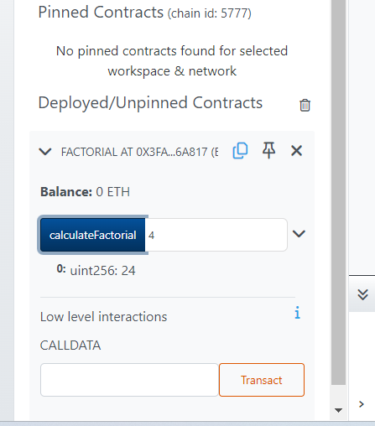
1)
2)

Slide 10
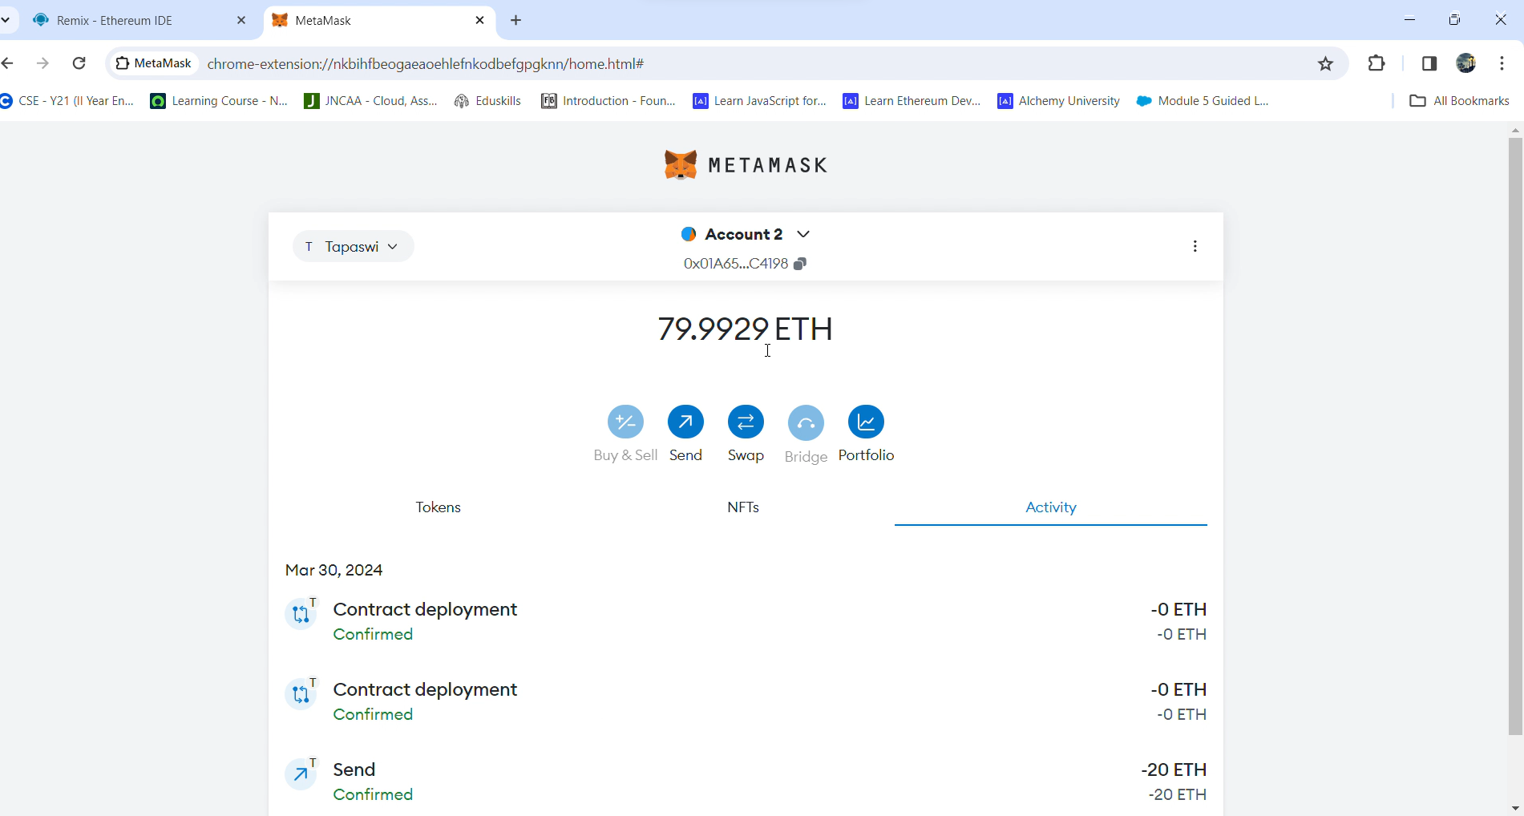

Slide 11


